Slide 1
Presentation on behat and cucumber

Slide 2
How cucumber works
Cucumber is a command-line tool.
When you run it, it reads in your specifications from plain-language text files called features, examines them for scenarios to test, and runs the scenarios against your system.
Each scenario is a list of steps for Cucumber to work through.
So that Cucumber can understand these feature files, they must follow some basic syntax rules.
The name for this set of rules is Gherkin.
Along with the features, you give Cucumber a set of step definitions, which map the business-readable language of each step into Ruby code to carry out whatever action is being described by the step

Slide 3
How cucumber works
If the Ruby code in the step definition executes without error, Cucumber proceeds to the next step in the scenario.
If it gets to the end of the scenario without any of the steps raising an error, it marks the scenario as having passed.
If any of the steps in the scenario fail, however, Cucumber marks the scenario as having failed and moves on to the next one.
As the scenarios run, Cucumber prints out the results showing you exactly what is working and what isn’t.

Slide 4
How cucumber works
you can write your specifications in more than forty different spoken languages.
you can use tags to organize and group your scenarios, and you can easily integrate with a host of high-quality Ruby automation libraries to drive almost any kind of application.

Slide 5
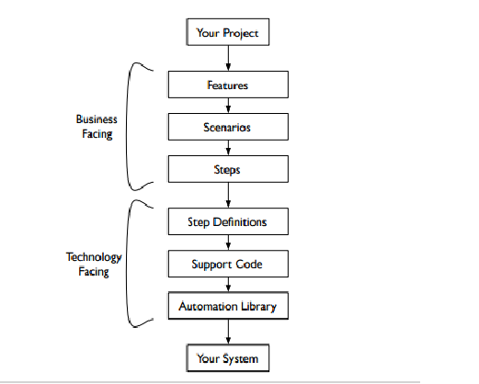
structure

Slide 6
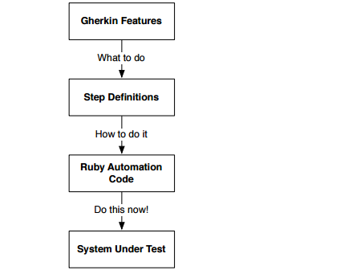
Flow of behat

Slide 7
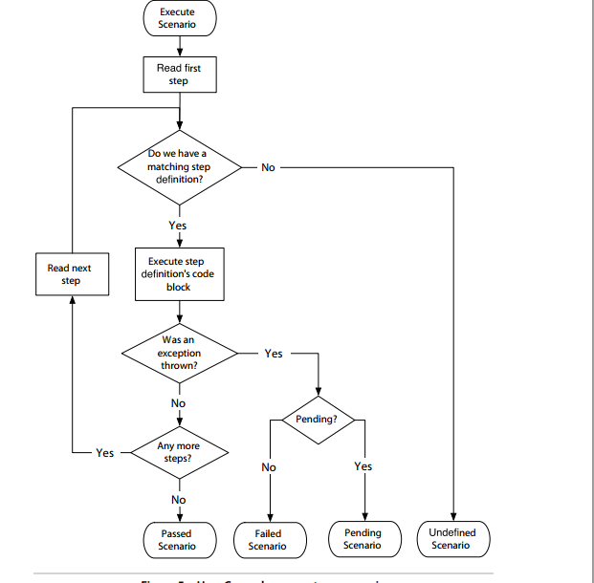
How cucumber execute a scenario

Slide 8
What Gherkin for?
When we build software for stakeholders or client, it is difficult to figure out exactly what they want us to build.
We’ve all worked on projects where, because of a misunderstanding, code that we’d worked hard on for several days or more had to be thrown away.
Better communication between developers and stakeholders is essential to help avoid this kind of wasted time.

Slide 9
We use the word acceptance because they tell us what the system must be able to do in order for our stakeholders to find it acceptable.
As a developer implementing this feature, we know almost everything we need to be able to sit down and start working on the code. As a stakeholder, we have a much clearer idea of what the developer is going to build.

Slide 10
Gherkin a programming language,4 its primary design goal is human readability, meaning you can write automated tests that read like documentation.
Format and Syntax Gherkin files use the .feature file extension. They’re saved as plain text, meaning they can be read and edited with simple tools.

Slide 11
Keywords
• Feature
• Background
• Scenario
• Given
• When
• Then
• And
• But
• *
• Scenario Outline
• Examples

Slide 12
Dry Run
command -cucumber test.feature --dry-run
Command behat test.feature --dry-run
The --dry-run switch tells Cucumber to parse the file without executing it. It will tell you if your Gherkin isn’t valid.

Slide 13
Feature
Each Gherkin file begins with the Feature keyword.
This keyword doesn’t really affect the behavior of your Cucumber tests at all;
it just gives you a convenient place to put some summary documentation about the group of tests that follow.
Here’s an example: Feature: This is the feature title This is the description of the feature, which can span multiple lines. You can even include empty lines, like this one: In fact, everything until the next Gherkin keyword is included in the description. The text immediately following on the same line as the Feature keyword is the name of the feature, and the remaining lines are its description. You can include any text you like in the description except a line beginning with one of the words Scenario, Background, or Scenario Outline. The description can span multiple lines. It’s a great place to wax lyrical with details about who will use the feature, and why, or to put links to supporting documentation such as wireframes or user research surveys. It’s conventional to name the feature file by converting the feature’s name to lowercase characters and replacing the spaces with underscores.

Slide 14
Valid feature
In valid Gherkin, a Feature must be followed by one of the following:
• Scenario
• Background
• Scenario Outline

Slide 15
Background
A background section in a feature file allows you to specify a set of steps that are common to every scenario in the file.
Instead of having to repeat those discuss steps over and over for each scenario, you move them up into a Background element.
There are a couple of advantages to doing this:
• If you ever need to change those steps, you have to change them in only one place.
• The importance of those steps fades into the background so that when you’re reading each individual scenario, you can focus on what is unique and important about that scenario.

Slide 16
Scenario
To actually express the behavior we want, each feature contains several scenarios..
a Scenario keyword can be followed by a name and description.
When Cucumber runs a scenario, if the system behaves as described in the scenario, then the scenario will pass; if not, it will fail.
Given to set up the context where the scenario happens,
When to interact with the system somehow,
and Then to check that the outcome of that interaction was what we expected.
We can add more steps to each Given, When, or Then section of the scenario using the keywords And and But:

Slide 17
Scenario Outline
Sometimes you have several scenarios that follow exactly the same pattern of steps, just with different input values or expected outcomes.
We can use a scenario outline to specify the steps once and then play multiple sets of values through them.
We indicate placeholders within the scenario outline using angle brackets (<>).
Behind the scenes, Cucumber converts each row in the Examples table into a scenario before executing it.
You can prove this to yourself by using the --expand option.

Slide 18
Creating Step Definitions
The scenario has graduated from undefined to pending.
This is good news, because it means Cucumber is now running the first step, but as it did so, it hit the call to pending inside our copied-and-pasted step definition code, which tells Cucumber that this scenario is still a work in progress.
We need to replace that pending marker with a real implementation.
Notice that Cucumber reports the two other steps as skipped.
As soon as it encounters a failed or pending step, Cucumber will stop running the scenario and skip the remaining steps.

Slide 19
There are three main reasons for tagging scenarios
• Documentation: You simply want to use a tag to attach a label to certain scenarios, for example to label them with an ID from a project management tool.
• Filtering: Cucumber allows you to use tags as a filter to pick out specific scenarios to run or report on. You can even have Cucumber fail your test run if a certain tag appears too many times.
• Hooks: Run a block of Ruby code whenever a scenario with a particular tag is about to start or has just finished.

Slide 20
Nesting steps
And I press "OK"

Slide 21
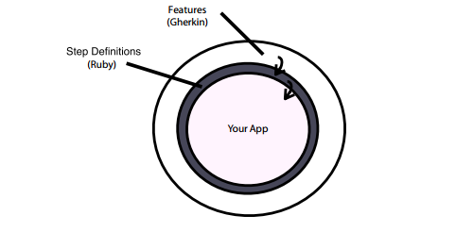
The main layers of a Cucumber test suite

